Slide 1
Ciphertext-Policy,
Attribute-Based Encryption
John Bethencourt
CMU
Amit Sahai
UCLA
Brent Waters
SRI International
Notes:
test

Slide 2
What is Ciphertext-Policy Attribute-Based Encryption (CP-ABE)?
Type of identity-based encryption
  One public key
  Master private key used to make more restricted private keys
But very expressive rules for which private keys can decrypt which ciphertexts
  Private keys have “attributes” or labels
  Ciphertexts have decryption policies
Notes:
So first I’m going to give a very quick general idea of what ciphertext-policy attribute-based encryption is.
-- Roughly, it can be viewed as a generalization of identity-based encryption. So as in identity-based encryption, there is a single public key, and there is a master private key that can be used to make more limited private keys.
-- However, CP-ABE is much more flexible than plain identity-based encryption, in that it allows complex rules specifying which private keys can decrypt which ciphertexts. Specifically, the private keys are associated with sets of attributes or labels, and when we encrypt, we encrypt to an access policy which specifies which keys will be able to decrypt.
Now before going into any more detail, I’m going to spend a little time talking about a general class of motivating applications which may clarify the context in which such a system might be used.

Slide 3







Remote File Storage:
Interesting Challenges
Scalability
Reliability
… But we also want security
Notes:
-- OK, so one thing we do all time is store our files on remote servers. There are a number of reasons why we do so.
-- We may want to provide scalable access to our files to others using additional resources available elsewhere.
-- We may want more reliability in case of failures. In this case we may want to replicate our files in different data centers or with different organizations.
-- But we want security. We may have requirements on who can access which files. The interesting thing is, there is a tension between security and the other properties. The more we replicate our files, the more we introduce potential points of compromise and the more trust we require. It’s this tension which makes this sort of problem interesting, and provides a context in which CP-ABE may be useful.

Slide 4


Remote File Storage:
Server Mediated Access Control
Sarah:
IT department,
backup manager
?
Good:
  Flexible access policies
Bad:
  Data vulnerable to compromise
  Must trust security of server
Access control list:
Kevin, Dave, and
anyone in IT department
Notes:
OK, so, moving on, let’s look out how people control access to remotely stored files. One general way you might handle this is to have a server decide for you.
-- So in this case, when we upload a file, we also provide a policy specifying who should be permitted to access the file.
-- Now when another user comes along and authenticates herself to the server somehow, the server can evaluate the policy
-- along with metadata the server may have about the user in order to
-- make a decision about whether allow access.
-- So what are the pros and cons of this general class of approaches to access control?

Slide 5


Remote File Storage:
Encrypting the Files
More secure, but loss of flexibility
New key for each file:
  Must be online to distribute keys
Many files with same key:
  Fine grained access control not possible
Notes:
OK, so what if someone is very concerned about the confidentiality of their files? Well, they can
-- encrypt their file before storing it, using either symmetric or public key encryption. Now the server can freely give out copies of the encrypted file to anyone. Now the problem of
-- controlling access to the file is a matter of
-- distributing the key.
-- But then things get more complicated as you encrypt more files.
-- Do you use a new key for each file? In that case, it probably won’t be feasible to distribute the keys ahead of time, since you don’t know all the files you are going to store in the future.
-- So you, or some other server, has to stay online to mediate access to the keys.
Alternatively, you could use a few keys to encrypt many files.
-- But then you lose the fine grained control we had over access policies.

Slide 6
Remote File Storage:
We Want It All
Wishlist:
  Encrypted files for untrusted storage
  Setting up keys is offline
  No online, trusted party mediating access to files or keys
  Highly expressive, fine grained access policies
Ciphertext-policy attribute-based encryption does this!
  User private keys given list of “attributes”
  Files can encrypted under “policy” over those attributes
  Can only decrypt if attributes satisfy policy

Slide 7
Remove File Storage:
Access Control via CP-ABE
✓
MSK
OR
✗
PK
✓
✗
✗
AND
IT dept.
✗
✓
manager
marketing
SK_{Sarah}:
“manager”
“IT dept.”
SK_{Kevin}:
“manager”
“sales”
Notes:
(point out that attributes of secret key are mathematically incorporated into the key itself)
(after file is encrypted, say we put it on the server)
(explain that now, the policy checking happens “inside the crypto”. that is, nobody explicitly evaluates the policies and makes an access decision. instead, if the policy is satisfied, decryption will just work, otherwise it won’t.)

Slide 8
Collusion Attacks:
The Key Threat
Important potential attack
Users should not be able to combine keys
Essential, almost defining property of ABE
Main technical trick of our scheme: preventing collusion
?
AND
A
B
SK_{Sarah}:
“A”, “C”
SK_{Kevin}:
“B”, “D”

Slide 9
Collusion Attacks:
A Misguided Approach to CP-ABE
Collusion attacks rule out some trivial schemes …
AND
PK_{A}
PK_{B}
PK_{C}
PK_{D}
A
B
SK_{A}
SK_{B}
SK_{C}
SK_{D}
M
= M₁ + M₂
SK_{Sarah}:
“A”, “C”
SK_{Kevin}:
“B”, “D”
C = (E_{A}(M₁), E_{B}(M₂))

Slide 10
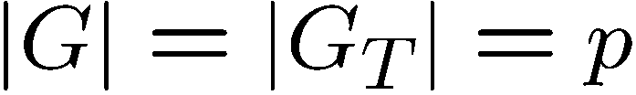


Highlights From Our Scheme:
Background

Slide 11
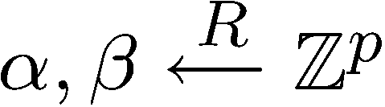
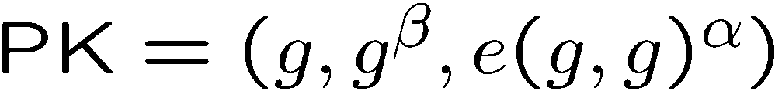

Highlights From Our Scheme:
Public Key and Master Private Key

Slide 12
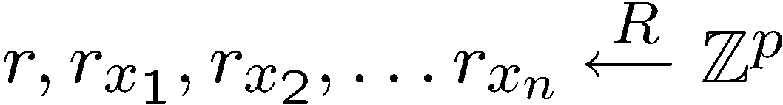
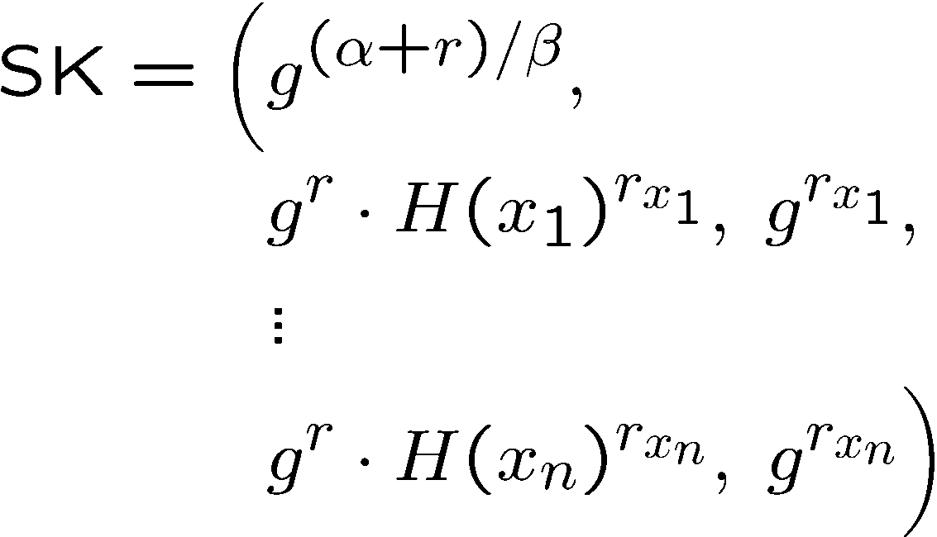
Highlights From Our Scheme:
Private Key Generation
“Binds” key components to each other
Makes components from different keys incompatible
Key to preventing collusion attacks

Slide 13
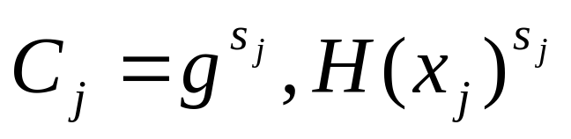
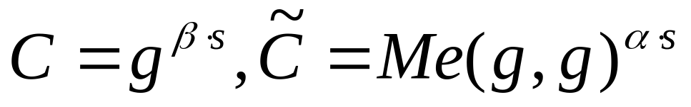
(GB addition): Encrypt
Simpler case of AND policy
AND policy
s ← random
Shares (AND example)
  s1 = s-d
  s2 = d
For each attr:
AND
x₁
x₂
For the whole message:

Slide 14
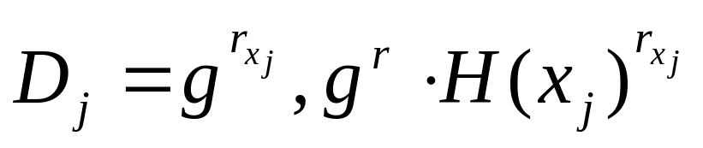
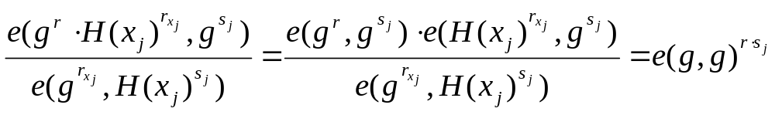
(GB addition): Decrypt (1)
Receive ciphertext, parse policy & attr
For each attr user has
  Ciphertext
  Secret key
Hence:

Slide 15
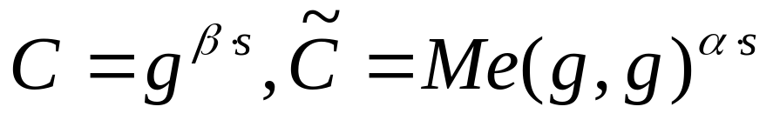
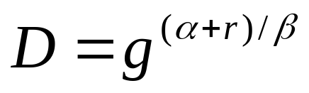
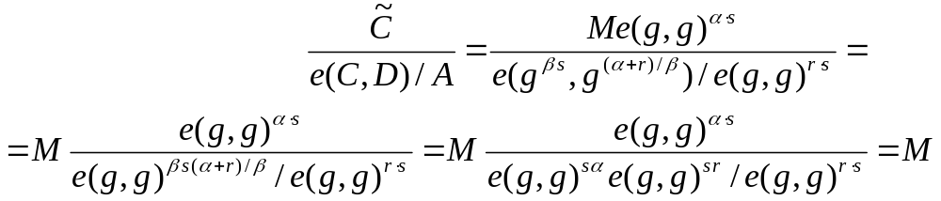
(GB addition): Decrypt (2)
For the simpler AND policy example
(generalization very easy, now..)
  Multiply terms
  Remember that
  And private key:
  Hence:

Slide 16
Highlights From Our Scheme:
Policy Features
Leaf nodes:
  Test for presence of string attribute in key
  Also numerical attributes and comparisons
Internal nodes:
  AND gates
  OR gates
  Also k of n threshold gates
OR
2 of 3
AND
IT dept.
OR
sales
manager
exec. level >= 5
marketing
hire date < 2002

Slide 17
Highlights From Our Scheme:
Encryption and Decryption
Encryption:
  Use general secret sharing techniques to model policy
  One ciphertext component per leaf node
Decryption:
  Uses LaGrange interpolation “in the exponents”
OR
2 of 3
AND
IT dept.
OR
sales
manager
exec. level >= 5
marketing
hire date < 2002

Slide 18
Highlights From Our Scheme:
Security
Proven secure, including collusion resistance
  Assumes random oracle model
  Assumes generic group model
Generic group model
  “Black box” heuristic similar to random oracle model
  Good future work: scheme without this assumption

Slide 19
Implementation:
The cp-abe Toolkit
$ cpabe-setup
$ cpabe-keygen -o sarah_priv_key pub_key master_key \
sysadmin it_dept 'office = 1431' 'hire_date = 2002'
$ cpabe-enc pub_key security_report.pdf
(sysadmin and (hire_date < 2005 or security_team)) or
2 of (executive_level >= 5, audit_group, strategy_team))

Slide 20
Implementation:
Performance
Benchmarked on 64-bit AMD 3.7 GHz workstation
Essentially no overhead beyond group operations in PBC library
Operation | Approximate Time
Private key gen. | 35 ms per attribute
Encryption | 27 ms per leaf node
Decryption | 0.5–0.8 ms per leaf node

Slide 21
Implementation:
Availability
Available as GPL source at Advanced Crypto Software Collection (ACSC)
  New project to bring very recent crypto to systems researchers
  Bridge the gap between theory and practice
  Total of 8 advanced crypto projects currently available
  http://acsc.csl.sri.com

Slide 22
Attribute Based Encryption:
Related Work
 | Collusion resistant | Policies w/ infinite attr. space | Policies w/ fixed attr. space | Attributes | Policy
[1,2] | Yes | Single thresh. gate | Single thresh. gate | In ciphertext | In key
[3] | Yes | Monotone formulas | All boolean formulas | In ciphertext | In key
This | Yes | Monotone formulas | All boolean formulas | In key | In ciphertext
[4]* | No | None | All boolean formulas | In key | In ciphertext
* Has additional policy hiding property, but needs online,
semi-trusted server to perform encryption

Slide 23
Attribute Based Encryption:
Related Work
[1] Sahai, Waters. Eurocrypt 2005.
[2] Pirretti, Traynor, McDaniel, Waters. CCS 06.
[3] Goyal, Pandey, Sahai, Waters. CCS 06.
[4] Kapadia, Tsang, Smith. NDSS 07.

Slide 24
Thanks for Listening!
bethenco@cs.cmu.edu
http://acsc.csl.sri.com

